Slide 1
Logistic Regression
Pranaav Paladugu and Oliver Grudinski

Slide 2
Overview of the Algorithm – Name and Purpose
The algorithm is called Logistic Regression. Logistic regression is designed to solve classification problems, especially when the goal is to predict a binary outcome such as “yes/no,” “buy/not buy,” or “disease/no disease”.

Slide 3
Overview of the Algorithm – Background
Logistic regression was formally developed and popularized by Joseph Berkson in the 1940s. Berkson introduced the logit model and established logistic regression as a statistical method.
Although the logistic function itself was discovered earlier by Adolphe Quetelet and Pierre-François Verhulst in the 19th century for modeling population growth.
The motivation for developing logistic regression is needed to analyze binary and categorical outcomes, such as “success/failure” decisions. Also, it provides clear interpretability through measures like the odds ratio, understand a how different features influence the likelihood of an outcome.
Notes:
Logistic regression was formally developed and popularized by Joseph Berkson in the 1940s. Although the logistic function itself was discovered earlier by Adolphe Quetelet and Pierre-François Verhulst in the 19th century for modeling population growth, Berkson introduced the logit model and established logistic regression as a statistical method.
The motivation for developing logistic regression came from the need to analyze binary and categorical outcomes, such as yes/no or success/failure decisions. In addition, logistic regression provides clear interpretability through measures like the odds ratio, making it useful for understanding how different features influence the likelihood of an outcome.

Slide 4
Overview of the Algorithm – Applications
It is commonly used for:
“Medicine & Health – has disease or not”
“Finance & Banking – fraudulent or legitimate”
“Sports Analytics – Win or Lose”

Slide 5
Problem Type
A logistic regression falls under the category of supervised learning, especially for classification tasks.
In supervised learning, the model is trained using labeled data, meaning each input is paired with a known output.
Logistic regression uses these labeled examples to learn the relationship between the features and the probability of belonging to a particular class.

Slide 6
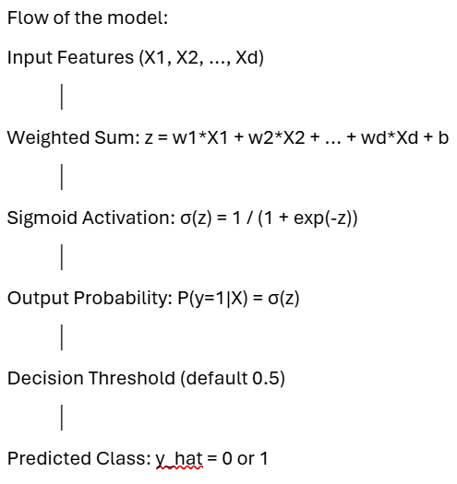
How the Algorithm Works?
Notes:
1. Input Features (X₁, X₂, …, Xd)
These are the variables or attributes used to make predictions. Each feature represents some measurable characteristic of the data.
2. Weighted Sum: z = w₁X₁ + w₂X₂ + … + wd*Xd + b
Logistic regression first computes a linear combination of the input features.
- Each feature $X_{i}$is multiplied by a learnable weight $w_{i}$.
- A bias term $b$is added to shift the decision boundary.
3. Sigmoid Activation: σ(z) = 1 / (1 + exp(-z))
Because classification requires a probability between 0 and 1, logistic regression passes the linear output $z$through the sigmoid (logistic) function.
- The sigmoid function “squashes” any real-valued number into a range from 0 to 1.
- A larger value of $z$results in a probability close to 1, while a very negative $z$ produces a probability close to 0.
4. Output Probability: P(y = 1 | X) = σ(z)
The result of the sigmoid function is interpreted as the predicted probability that the target class $y$is equal to 1 given the input features $X$.
For example, the model might output:
- 0.87 → 87% chance of “positive” or class 1
- 0.12 → 12% chance of class 1
5. Decision Threshold (default = 0.5)
To convert the probability into a class label, logistic regression uses a threshold.
- If the probability is greater than or equal to 0.5, the prediction is class 1.
- If it is less than 0.5, the prediction is class 0.
6. Predicted Class: ŷ = 0 or 1
Finally, the model outputs the predicted class label:
- ŷ = 1 if the probability meets or exceeds the threshold
- ŷ = 0 otherwise

Slide 7
Computational Complexity
Training Complexity is O(n⋅d⋅k):
  n = number of training samples
  d = number of features
  k = number of gradient descent iterations
Prediction Complexity is O(d)

Slide 8
Example Application
Notes:
Example Application will based on Marketing

Slide 9
Our Mission
The main objective of our model is to predict which customers are most likely to respond to a product or service offer. This allows businesses to focus their marketing resources more efficiently, improve conversion rates, and make more informed strategic decisions.
We can identify which types of customers are more likely or less likely to respond to a marketing campaign by using this Dataset from Kaggle called Marketing Campaign. By examining consumer attributes such as education level, marital status, income, number of children, and other demographic or behavioral variables

Slide 10
Dataset Description
Number of samples: 2,240 customers
Number of features: 24 input features after encoding (skip DTcustomer, Complain, Z_CostContact, Z_Revenue)
Target variable: Response — 1 if the customer accepted the most recent campaign, 0 otherwise

Slide 11
Implementation – Data Preprocessing
Load Dataset
Cleaning / Handling Missing Values
Define Features and Target
Preprocessing: Encoding & Scaling
Train / Validation / Test Split
Fit Preprocessor and Transform
Output shapes
Notes:
1. Load Dataset
The dataset is loaded from a CSV file, and the column names are cleaned to remove extra spaces.
2. Cleaning / Handling Missing Values
- Numeric features are imputed using the median, which is robust to outliers and preserves the distribution.
- Categorical features are filled with their most frequent category (mode) to avoid losing data while keeping categories valid.
3. Define Features and Target
The target variable (Response) is separated from the feature set. Irrelevant or non-informative columns such as ID fields and administrative variables (Dt_Customer, Z_CostContact, Z_Revenue) are dropped. This prevents data leakage and ensures that the model learns only from meaningful information.
4. Preprocessing: Encoding & Scaling
A preprocessing pipeline is created using ColumnTransformer.
- Numeric features are standardized to have mean 0 and variance 1, improving model stability.
- Categorical features are one-hot encoded, converting categories into binary indicator variables.
5. Train / Validation / Test Split
The dataset is divided into three parts:
- Training set (64%) for model learning
- Validation set (16%) for hyperparameter tuning
- Test set (20%) for final performance evaluation
6. Fit Preprocessor and Transform
The preprocessing pipeline is fitted only on the training set, then applied to the validation and test sets. This prevents information from the validation or test data from leaking into the training process, so it can ensure an honest evaluation of model performance.
7. Output Shapes
The shapes of the processed feature matrices and label vectors are printed. This is confirmation that the preprocessing steps were successful, and give information of the training, validation, and test sets contain the expected number of samples and transformed features.

Slide 12
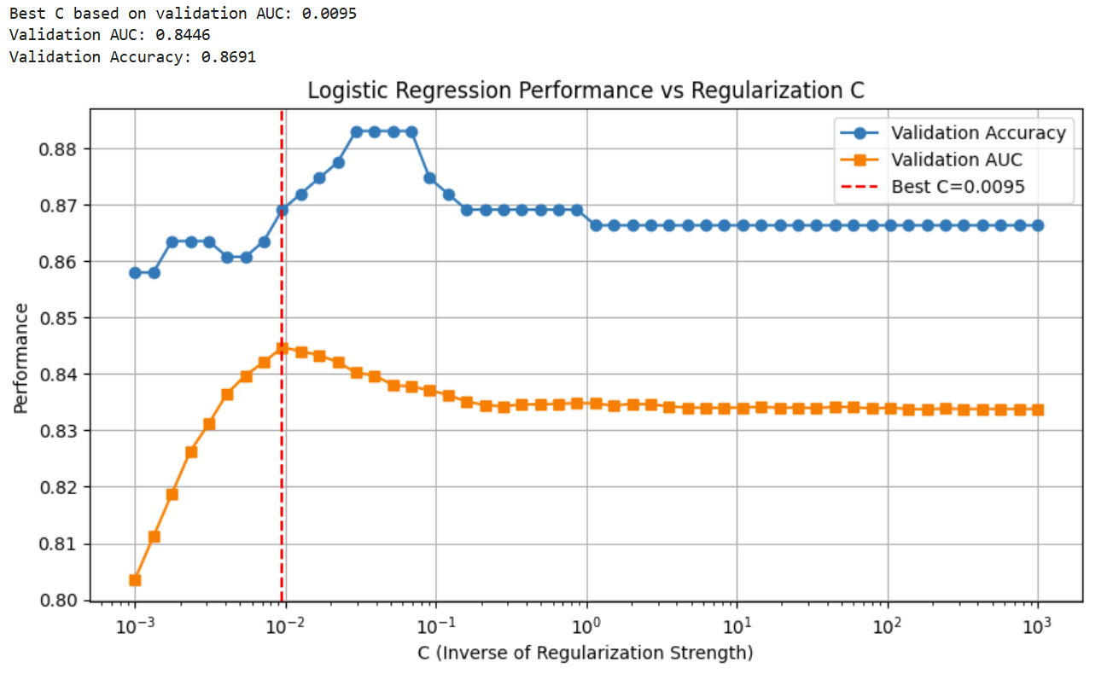
Implementation – Hyperparameter Search for Logistic Regression
Notes:
1. Define Hyperparameter Range
A range of C values is created using a logarithmic scale from 0.001 to 1000.
C controls the inverse of regularization strength:
- Small C → stronger regularization (simpler model)
- Large C → weaker regularization (more flexible model)
2. Train Logistic Regression for Each C
A logistic regression model is trained repeatedly, one for each C value.
The model is fit only on the training data.
Predictions on the validation set provide:
Accuracy: measures how many labels were predicted correctly
AUC (Area Under ROC): measures ranking/separation ability between classes AUC is often preferred because it is more robust to class imbalance. Both metrics are stored for comparison.
3. Find the Best Parameter
The best C value is selected by choosing the model with the highest validation AUC.
This avoids overfitting to accuracy alone and focuses on probability quality and class separation.
4. Plot Performance
A performance curve is created for AUC and accuracy across all C values.
- A logarithmic x-axis visually highlights how performance changes with regularization.
- A vertical line marks the best C.

Slide 13
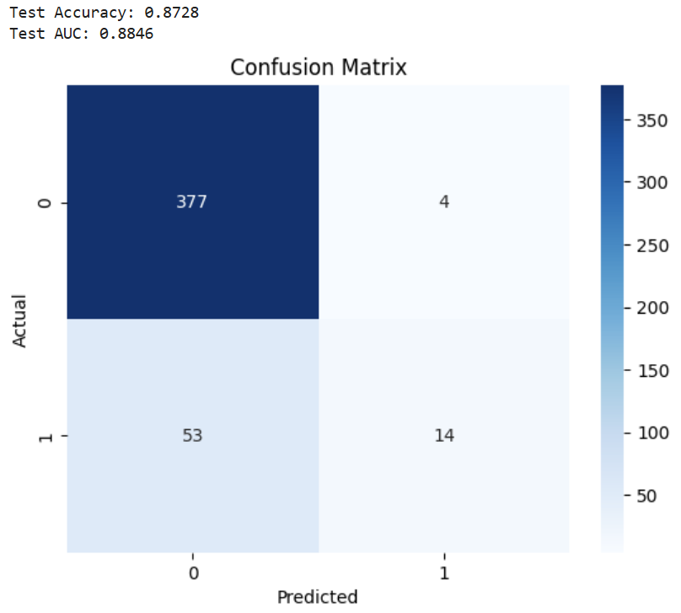
Evaluation – Confusion Metrics

Slide 14
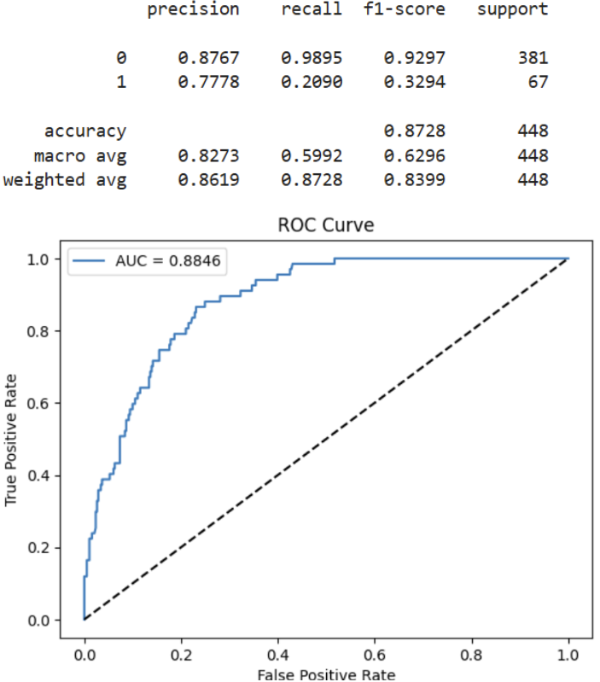
Evaluation – ROC curve

Slide 15
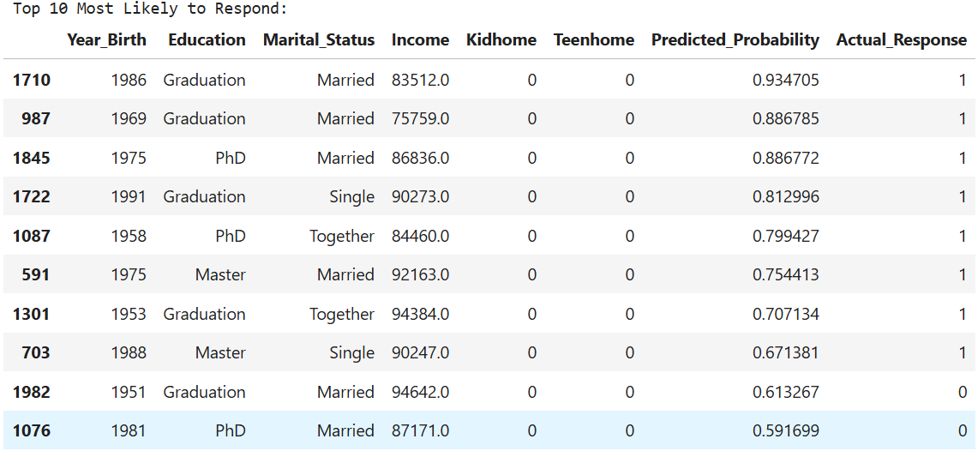
Evaluation – Interpret the coefficients Part 1

Slide 16
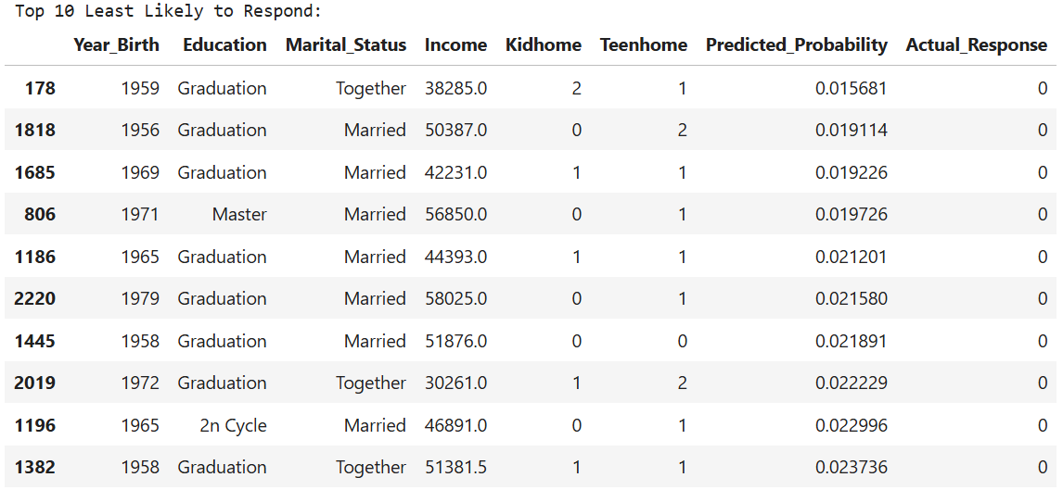
Evaluation – Interpret the coefficient Part 2

Slide 17
Advantages and Disadvantages
Strengths:
- Coefficients are easy to interpret. They directly show how features influence the log-odds of the outcome.
- High performance on linearly separable data.
- Simplicity due easy to implement and tune.
Weaknesses:
- Overfitting can happen when there are many correlated features, or the dataset is small.
- It heavily requires proper learning rate, regularization strength, and feature scaling.
- Often struggle with datasets that have complex structure, large interactions, or unobserved nonlinear patterns.

Slide 18
Comparison and Alternatives

Slide 19
References:
GeeksforGeeks. (2017, May 9). Logistic Regression in Machine Learning. GeeksforGeeks. https://www.geeksforgeeks.org/machine-learning/understanding-logistic-regression/
‌ Lee, F. (2025, May 14). Logistic Regression. Ibm.com. https://www.ibm.com/think/topics/logistic-regression
Brownlee, J. (2016, September 22). Logistic Regression for Machine Learning. Machine Learning Mastery. https://machinelearningmastery.com/logistic-regression-for-machine-learning/

